Slide 1
Market Basket Analysis
By:- Darshan Sanjay Gunjal (226506)
Purva Deepak Kolhe (226518)

Slide 2

Introduction
Market basket analysis is a data mining technique used by retailers to increase sales by better understanding of customer purchasing patterns.
It involves analyzing large data sets, such as purchase history, to reveal product groupings, as well as products that are likely to be purchased together.
Market basket analysis is a process that look for relationship among entities and object that frequent appear together such as collection of items in shoppers cart

Slide 3
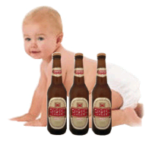
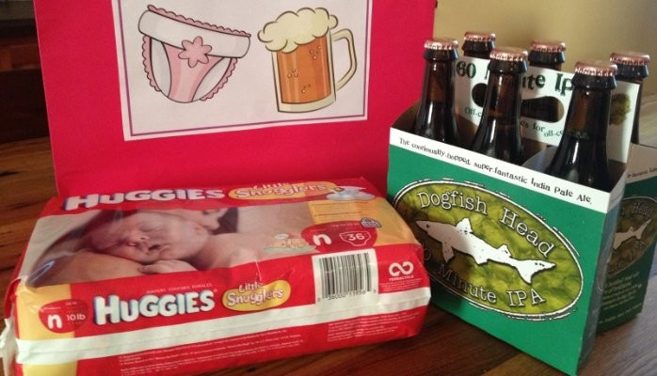
Example :- Beer & Nappies
An observant Wal-Mart store manager discovered a strong association between a brand of babies nappies (diapers) and a brand of beer. Analysis of purchases revealed that they were made by men, on Friday evenings mainly between 6pm and 7 pm. The supermarket figured out the following rationale:
• Because packs of diapers are very large, the wife who in most cases made the household purchases, left the diaper purchase to her husband.
• Being the end of the working week, the husband and father also wanted to get some beer in for the weekend.

Slide 4
Frequent Pattern :- There are many kind of frequent pattern include frequent items, it frequent subsequence and frequent substructure a frequent item set of item that often appear together in the transactional data set. For example, butter and bread, which are frequent bought together in the grocery store by number of customer .
Association :- Association are used in retail sales to identify pattern that are frequent purchased together. This process refer to process of uncovering the relationship among data and determine association rule. For example retailer generates association rule that shows that 70% of milk is sold with bread and only 30% of times biscuits are sold with bread.
Correlation :- It is a kind of additional analysis performed to uncover, interesting statistical correlation between associate-attribute-value pair, or between two item set to analyze that if they have positive ,negative or no effect on each other.

Slide 5
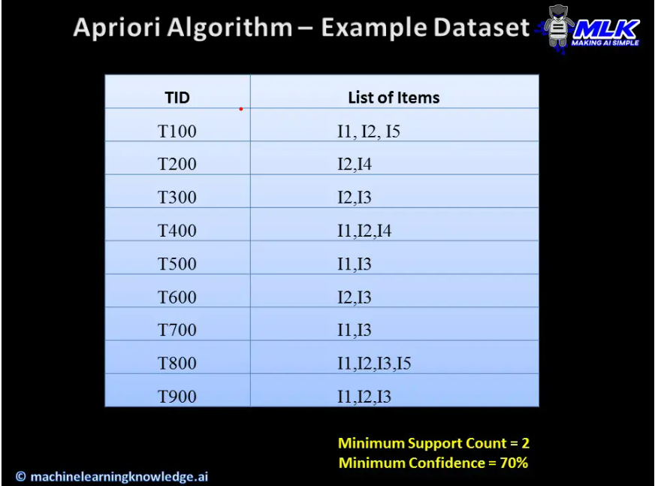
Apriori Algorithm
Apriori algorithm is given by R. Agrawal and R. Srikant in 1994 for finding frequent itemset in a dataset for Boolean association rule. Name of the algorithm is Apriori because it uses prior knowledge of frequent itemset properties. We apply an iterative approach or level-wise search where k-frequent itemset are used to find k+1 itemsets.
To improve the efficiency of level-wise generation of frequent itemset, an important property is used called Apriori property which helps by reducing the search space.

Slide 6
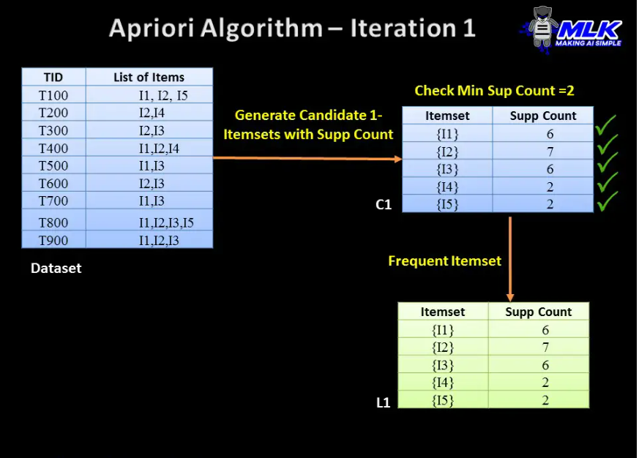
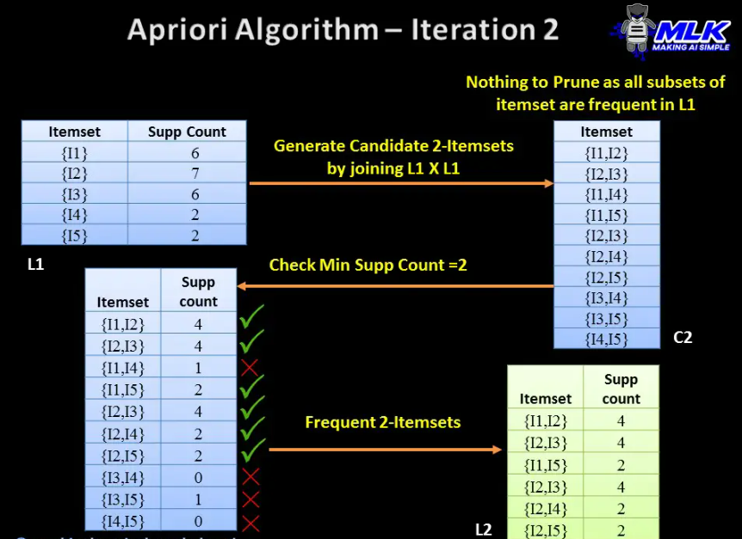

Slide 7
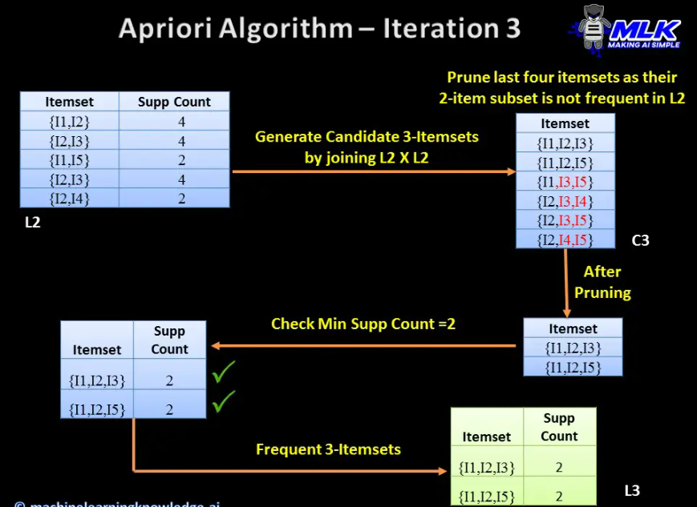
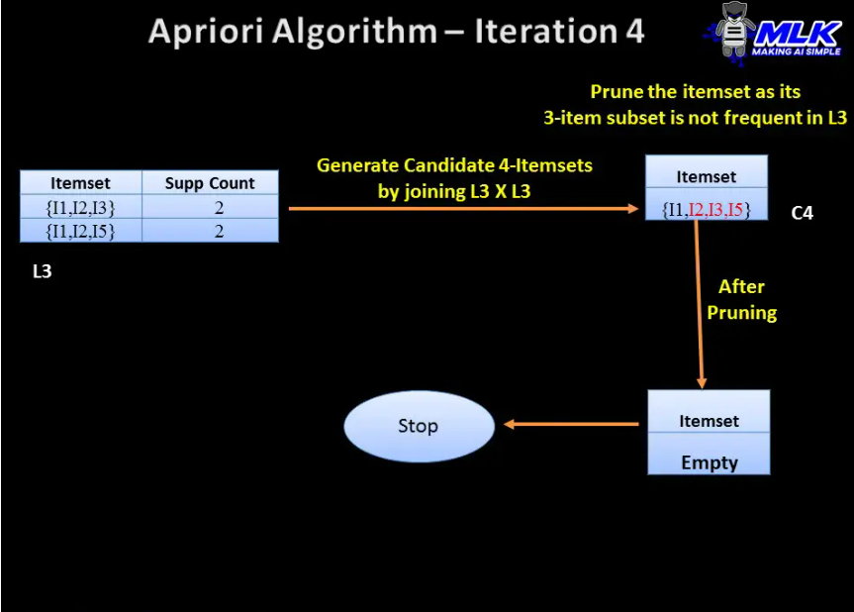

Slide 8
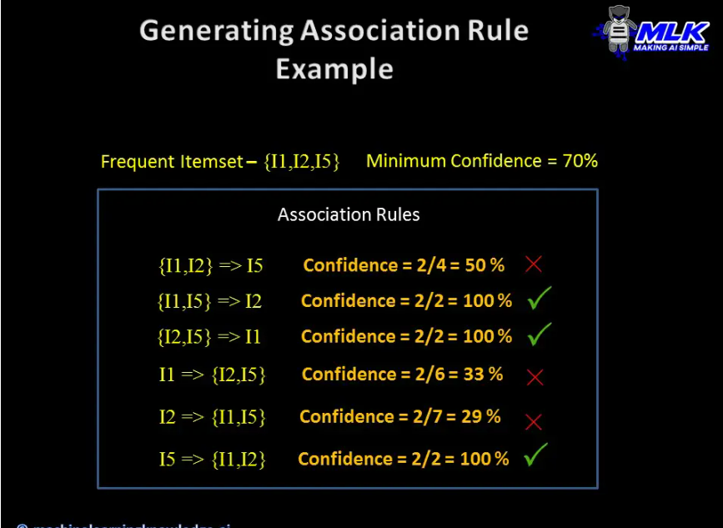

Slide 9
APPLICATION OF MARKET BASKET ANALYSIS :
CROSS SELLING :
Businesses define cross-selling in many different ways depending on the factors involved. But in simple words cross-selling is a technique where a seller suggests complementary goods to customers with the primary product which is already purchased. MBA helps retailers to understand the behavior of the customer and then go for cross-selling.
CUSTOMER BEHAVIOUR :
Customer behavior in general is a study of how an individual or a group of customers purchase to satisfy their needs and wants. As I mentioned above Market Basket Analysis helps to understand the consumer behavior. It provides an insight into customer purchasing patterns and helps retailers to identify the relationship between two products where a customer tends to purchase.
FRAUD DETECTION :
Market Basket Analysis is also applied to detect fraud. You might ask how? It is possible to identify fraudulent transactions by understanding customer behavior under different conditions. For instance data that contains the usage of credit card can help us in detecting fraud which is associated with purchase behavior.

Slide 10
